Slide 1
Cyclistic Case Study
Converting Casual Riders into Annual Members
Aleksandr Svirskii | Data Analytics Portfolio | 2026

Slide 2
Presentation Overview
Business Problem
Hypothesis & Metrics
Behavioral Insights
Strategic Recommendations

Slide 3
Annual Membership Growth Drives Long-Term Profitability
Stakeholders: Marketing Director & Executive Team
Goal: Increase annual memberships
Dataset: 5.5M rides across 12 months

Slide 4
Hypothesis: Members Commute, Casual Riders Ride for Leisure
Behavioral differences indicate intent
Intent can guide targeted conversion strategy

Slide 5
Core Metrics Used to Evaluate Behavior
Average ride duration
Hourly ride distribution
Weekday vs weekend usage
Monthly seasonality trends

Slide 6
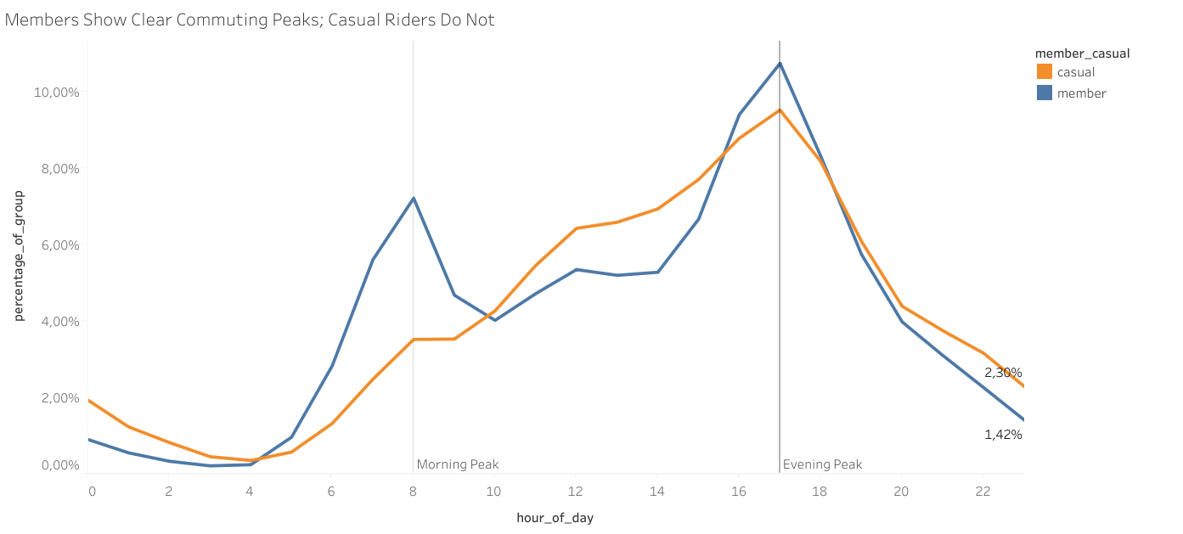
Members Show Strong Commuting Peaks
Insight: Usage Patterns Confirm Routine Integration
Members peak at 8 AM and 5 PM
Casual riders ride mostly mid-day
Clear commute vs leisure split

Slide 7
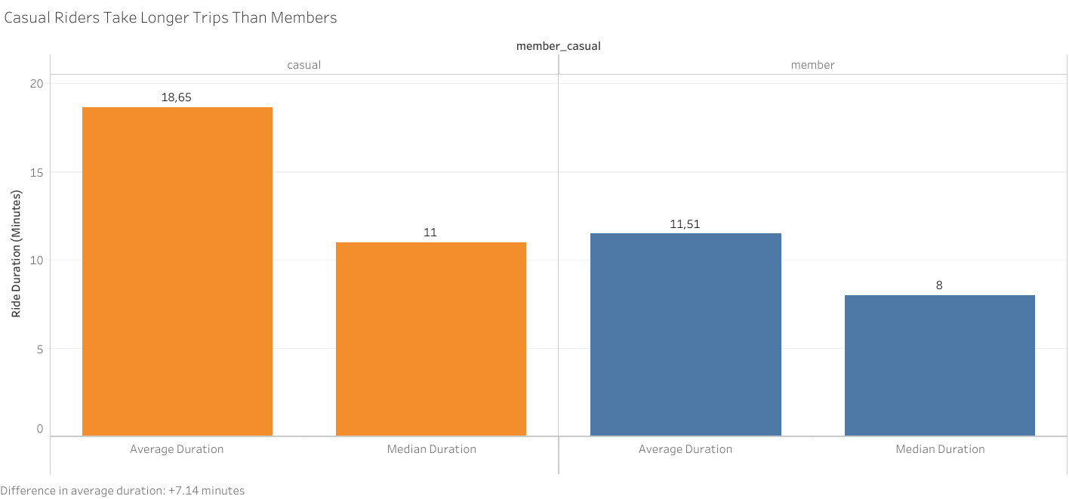
Casual Riders Spend 60% More Time per Ride
Insight: Longer Rides Reflect Leisure Behavior
Casual average: ~18.6 min
Member average: ~11.5 min
Frequent long rides signal upgrade potential

Slide 8
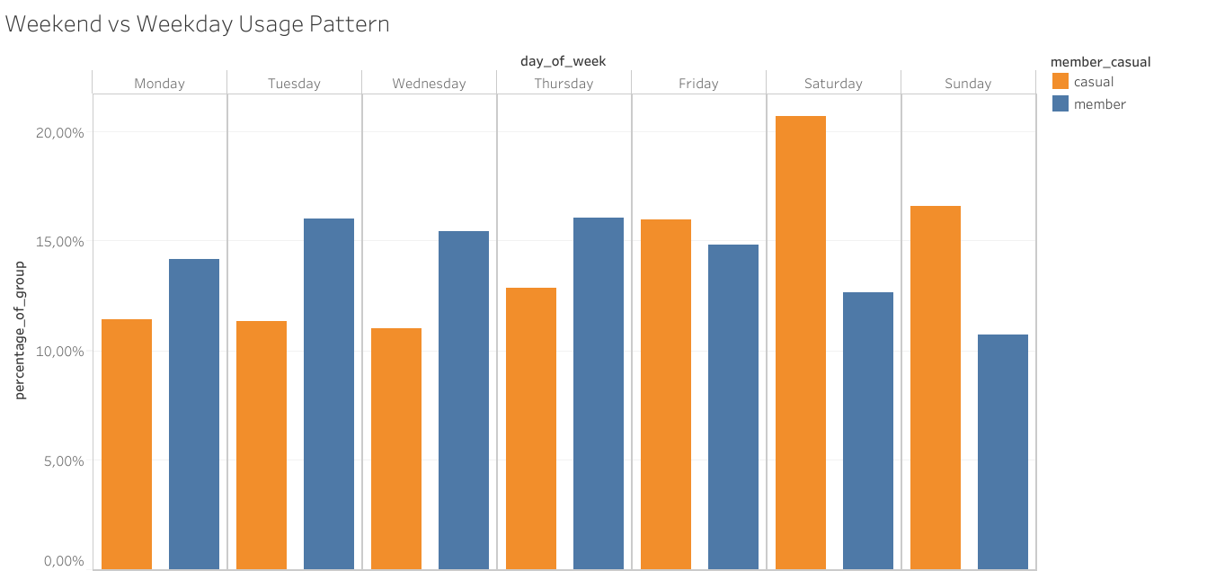
Weekend vs Weekday Split Is Significant
Insight: Members Dominate Weekdays, Casual Riders Weekends
Members integrate bikes into work routines
Casual riders show recreational engagement

Slide 9
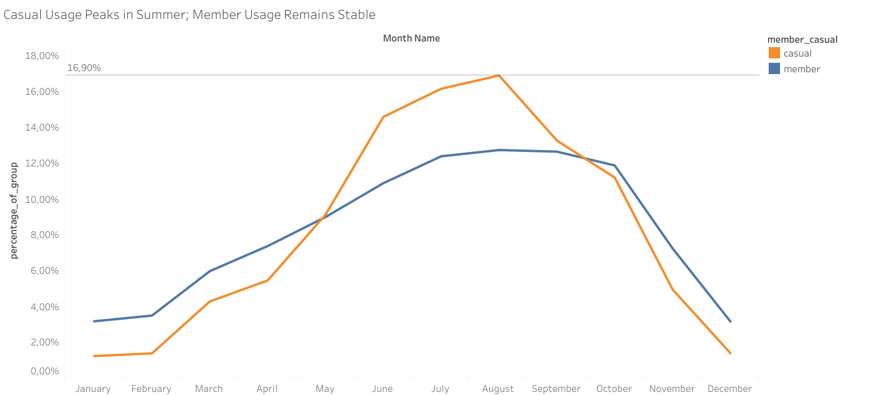
Casual Usage Is Highly Seasonal
High Engagement Without Habit Lock-In:
Casual riders are active but seasonal
Behavior signals strong conversion opportunity

Slide 10
Targeted Strategy Can Convert Engagement into Recurring Revenue
Introduce a limited-time discounted annual membership offer.
Offer summer-focused membership.
Develop a weekend-only subscription model.

Slide 11
Thank You

